Slide 1
BMP280 Sensor communicate with Android Things
Notes:
Reference:
https://github.com/androidthings/drivers-samples/tree/master/bmx280
https://github.com/androidthings/contrib-drivers/tree/master/bmx280

Slide 2



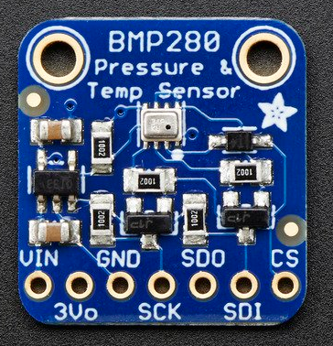

Temperature sensor sample for Android Things
Environment For Raspberry pi 3 Model B
Devices
Raspberry pi 3 model B
BMP 280
Platform
Android things
Environment For Desktop
OS
Window 10
Software
Android Studio
Android Debug Bridge (ADB)
Notes:
Peripheral I/O: communication APIs to sensors and actuators
General Purpose Input/Output(GPIO):
use to read the state of a binary input device and control the on/off state of a binary output device
Adding permission to manifest file
Connect port: in order to open connection to a CPIO port you will using unique GPIO port name to open connection.
Read:
setDirection() with DIRECTION_IN
Current state by getValue()
Close connection: in order to free up resources.
Pulse Width Modulation(PWM): use to control actuators
Serial Communication: use to transfer larger payloads of data between two or more smart devices connected on the same local bus.

Slide 3
Development of temperature sensor
Start Android Studio
Programming
Connect with Android Things Through ADB(Android Debug Bridge)

Slide 4
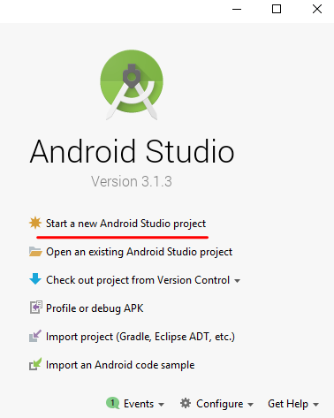
Development of temperature sensor
Start Android Studio
Start a new Android Studio project
Programming
Connect with Android Things Through ADB(Android Debug Bridge)

Slide 5
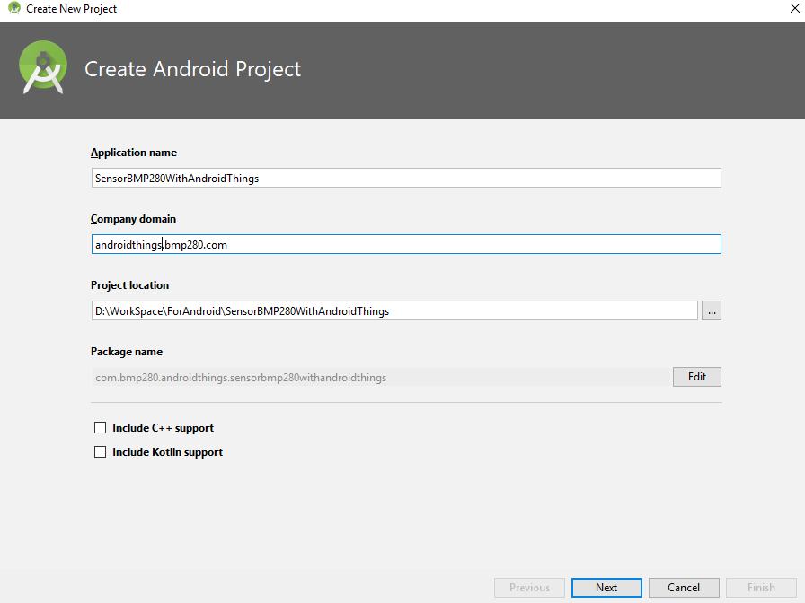
Development of temperature sensor
Start Android Studio
Start a new Android Studio project
Set information of Application name, Company domain, Project location
Programming
Connect with Android Things Through ADB(Android Debug Bridge)
Notes:
Application name: application`s name
Company domain:
Project location: workspace for your project
Revert your company domain + application name = package name

Slide 6
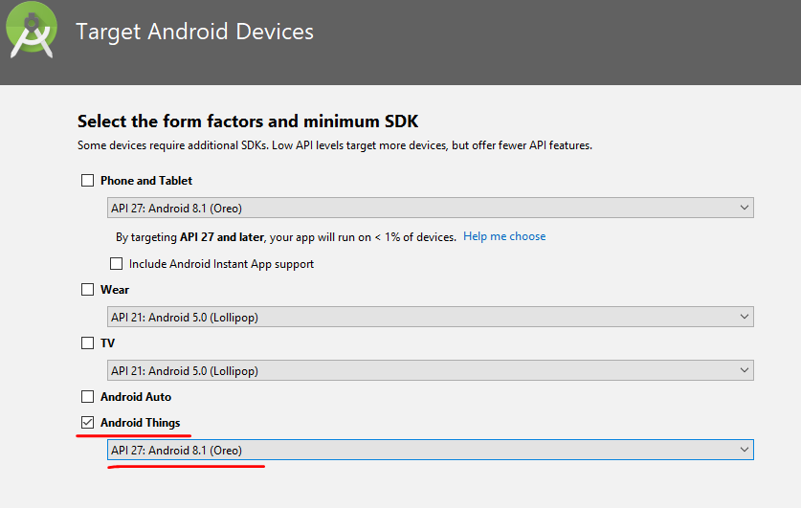
Development of temperature sensor
Start Android Studio
Start a new Android Studio project
Set information of Application name, Company domain, Project location
Choose device and Android things version
Programming
Connect with Android Things Through ADB(Android Debug Bridge)

Slide 7
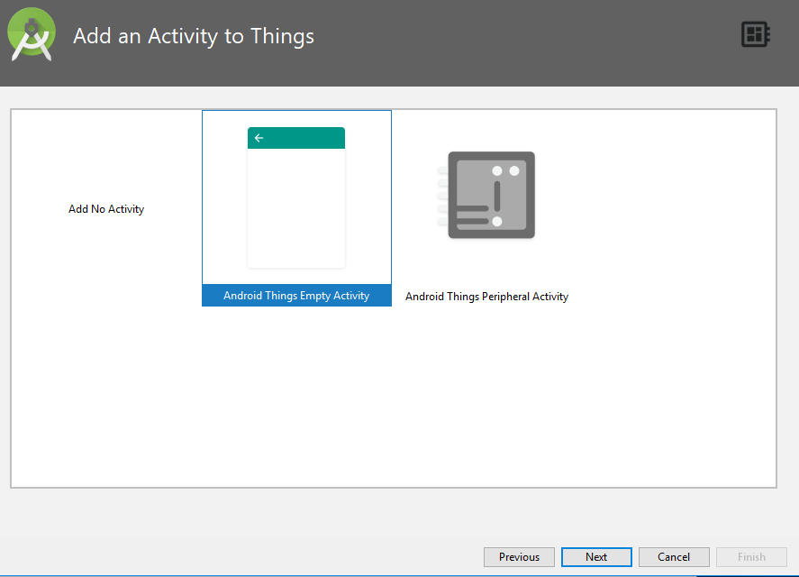
Development of temperature sensor
Start Android Studio
Start a new Android Studio project
Set information of Application name, Company domain, Project location
Choose device and Android things version
Add Activity : default
Programming
Connect with Android Things Through ADB(Android Debug Bridge)

Slide 8
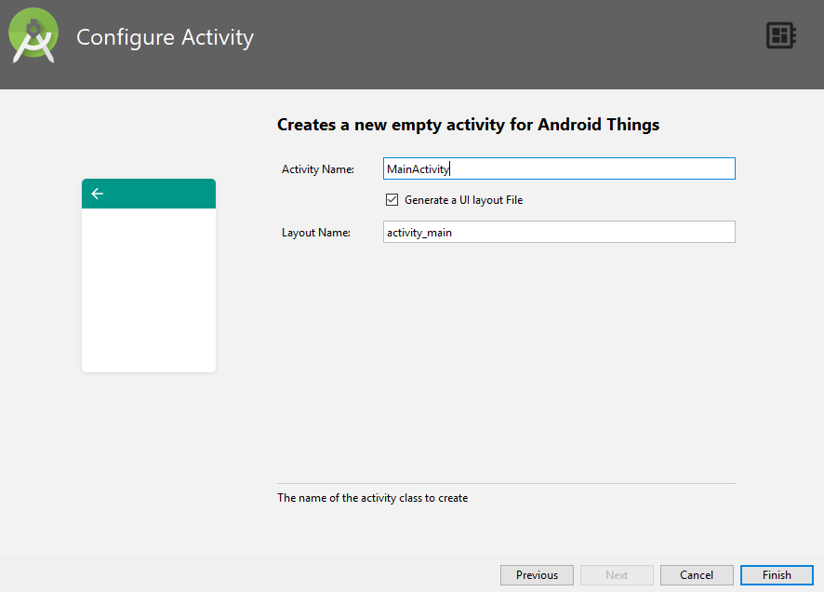
Development of temperature sensor
Start Android Studio
Start a new Android Studio project
Set information of Application name, Company domain, Project location
Choose device and Android things version
Add Activity : default
Configure Activity: default
Programming
Connect with Android Things Through ADB(Android Debug Bridge)

Slide 9
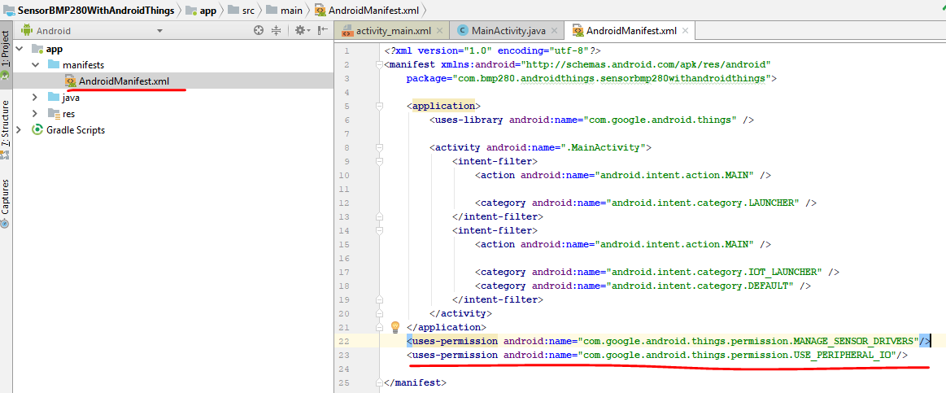
Development of temperature sensor
Start Android Studio
Programming
Add permission
Connect with Android Things Through ADB(Android Debug Bridge)

Slide 10
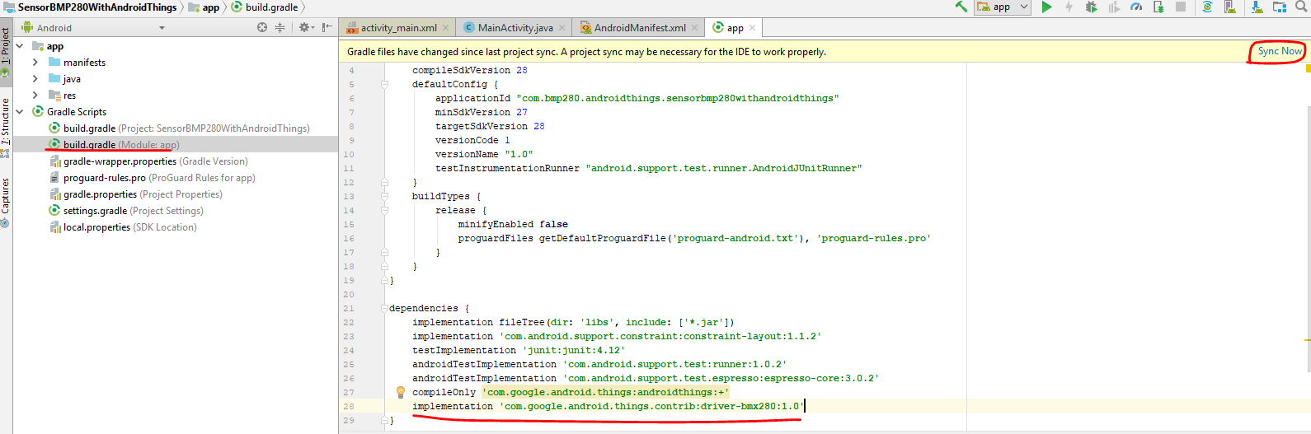
Development of temperature sensor
Start Android Studio
Programming
Add permission
Add dependencies
Connect with Android Things Through ADB(Android Debug Bridge)

Slide 11
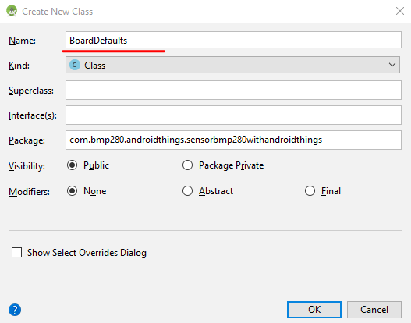
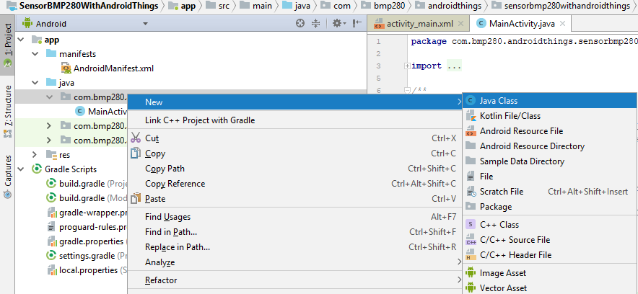
Development of temperature sensor
Start Android Studio
Programming
Add permission
Add dependencies
Add code
Add Class BoardDefaults
Connect with Android Things Through ADB(Android Debug Bridge)
Notes:
BoardDefaults class: return alternate functions for each board design

Slide 12
Development of temperature sensor
Start Android Studio
Programming
Add permission
Add dependencies
Add code
Add Class BoardDefaults
Add code in MainActivity
Connect with Android Things Through ADB(Android Debug Bridge)
import android.os.Build; @SuppressWarnings("WeakerAccess") public class BoardDefaults { // The name of the industrial design private static final String DEVICE_RPI3 = "rpi3"; private static final String DEVICE_IMX6UL_PICO = "imx6ul_pico"; private static final String DEVICE_IMX7D_PICO = "imx7d_pico"; /** * Return the preferred I2C port for each board. */ public static String getI2CPort() { switch (Build.DEVICE) { case DEVICE_RPI3: return "I2C1"; case DEVICE_IMX6UL_PICO: return "I2C2"; case DEVICE_IMX7D_PICO: return "I2C1"; default: throw new IllegalStateException("Unknown Build.DEVICE " + Build.DEVICE); } } }
Notes:
Annotations: allow us to add metadata information into out source code but not affect the execution of the program). Begin with JDK 5.
Instructions to the compiler: there are three built-in annotations available in java(@ Deprecated, @Override, @SuppressWarnings) that can bu used for giving certain instructions to the compiler.
SuppressWarnings: instructs compiler to ignore specific warnings.
Compile-time instructors: Annotations can provide compile-time instructions to the compiler that can be further used by software build tools for generating code, XML files etc.
Runtime instructions: we can define annotations to be available at runtime which we can access using java reflection and can be used to give instructions to the program at runtime.
Annotations can be applied to the classes, interfaces, methods and fields.

Slide 13
Development of temperature sensor
Start Android Studio
Programming
Add permission
Add dependencies
Add code
Add Class BoardDefaults
Add code in MainActivity
Connect with Android Things Through ADB(Android Debug Bridge)
private static final String TAG = "Android sensor test"; private Bmx280 mBmx280; @Override protected void onCreate(Bundle savedInstanceState) { super.onCreate(savedInstanceState); setContentView(R.layout.activity_main); try {
// make instance for BMP driver mBmx280 = new Bmx280(BoardDefaults.getI2CPort()); // Configure driver settings according to your use case mBmx280.setTemperatureOversampling(Bmx280.OVERSAMPLING_1X); mBmx280.setMode(Bmx280.MODE_NORMAL); //wake up sensor Log.i(TAG,"connect with sensor"); } catch (IOException e) { } new Thread(new Runnable() { //make thread for period read temperature public void run() { while (true) { try { Log.i(TAG, "start thread"); Thread.sleep(1000); float temperature = mBmx280.readTemperature(); Log.i(TAG, String.valueOf(temperature)); } catch (IOException e) { // error reading temperature } catch (InterruptedException e) { e.printStackTrace(); } } }).start(); }

Slide 14
Development of temperature sensor
Start Android Studio
Programming
Add permission
Add dependencies
Add code
Add Class BoardDefaults
Add code in MainActivity
Connect with Android Things Through ADB(Android Debug Bridge)
@Override protected void onDestroy() { super.onDestroy(); Log.i(TAG, “disconnect with sensor"); if (mBmx280 != null) { try { mBmx280.setMode(Bmx280.MODE_SLEEP); mBmx280.close(); } catch (IOException e) { // error closing sensor } } }

Slide 15
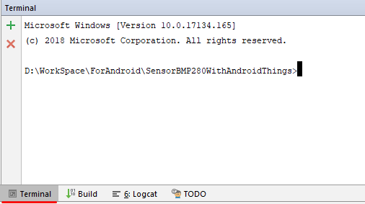
Development of temperature sensor
Start Android Studio
Programming
Connect with Android Things Through ADB(Android Debug Bridge)
Start terminal
Notes:
Problem
adb is not recognized as an internal or external command
Resolution
set environment variable to path
Click start
Type edit environment variables for your account
Double Click path
Click new
Paste that path in
adb tool is located in C:\Users\[your user name]\AppData\Local\Android\sdk\platform-tools by default

Slide 16
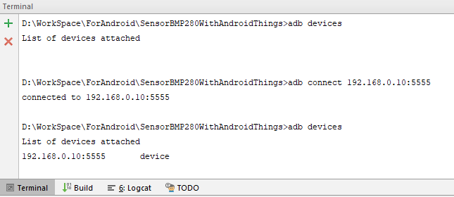
Development of temperature sensor
Start Android Studio
Programming
Connect with Android Things Through ADB(Android Debug Bridge)
Start terminal
connect with device through adb
IP for device
Port 5555 default

Slide 17
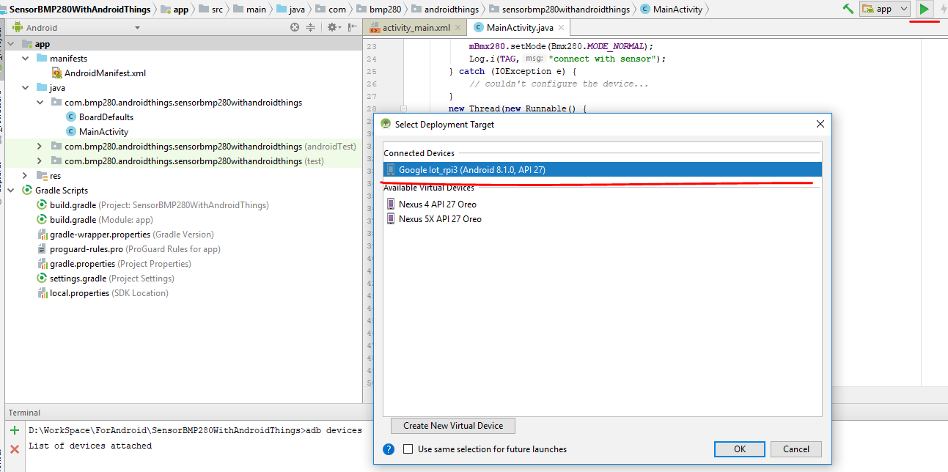
Development of temperature sensor
Start Android Studio
Programming
Connect with Android Things Through ADB(Android Debug Bridge)
Execute Application

Slide 18
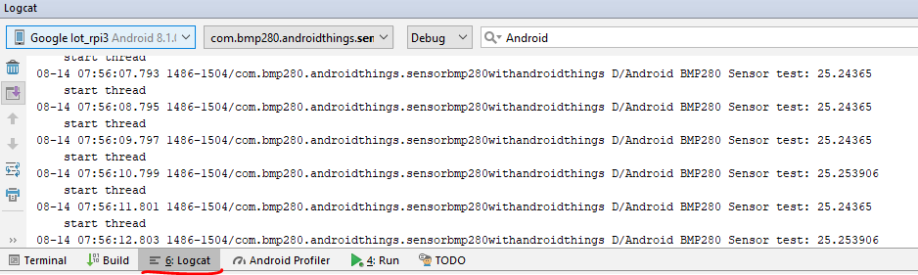
Development of temperature sensor
Start Android Studio
Programming
Connect with Android Things Through ADB(Android Debug Bridge)
Execute Application

Slide 19
Reference
https://github.com/androidthings/drivers-samples/tree/master/bmx280
https://github.com/androidthings/contrib-drivers/tree/master/bmx280
http://www.robot-electronics.co.uk/i2c-tutorial
https://beginnersbook.com/2014/09/java-annotations/

